Slide 1
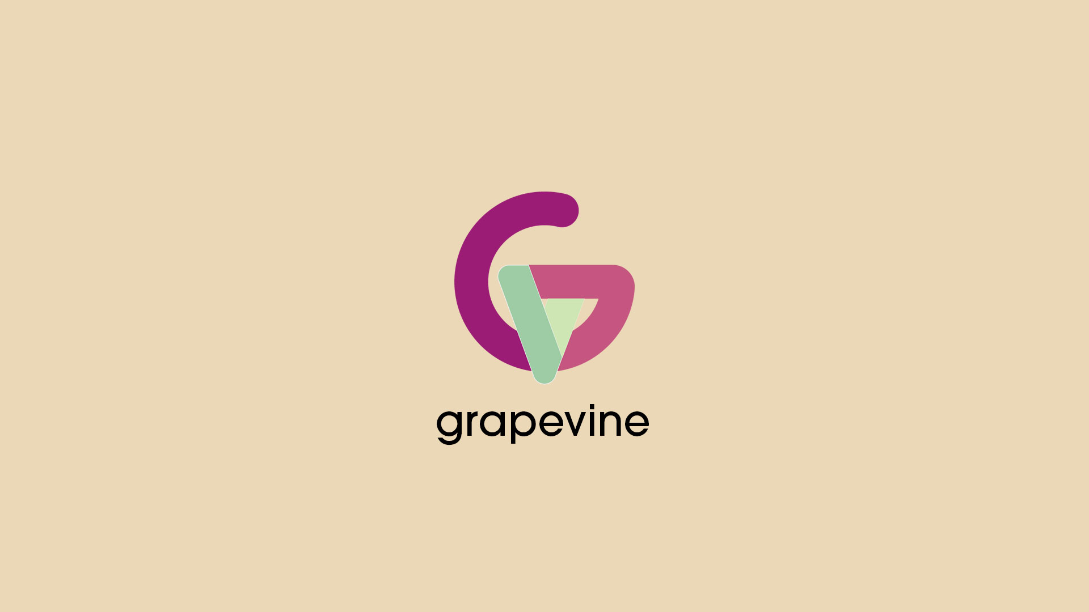

Slide 2











IDEA
NOVEL
COMMUNICATIVE
Grapevine is a new idea that provides
greater possibilities for employees
Post about experiences with certain jobs,
and who they might be fit for
FIRST HAND
REVOLUTIONARY
Gives prospective employees information
from those on the front line
Grapevine has the ability to completely
redefine searching for a job

Slide 3

DESIGN
TAILORED
Sought feedback after state competition
in order to tailor app to audience
SAFE
The app is built with the ability to
change name for anonymity
CROSS-PLATFORM
CONDENSED
Built to launch on all Apple devices
and has Android version
Built an app with a condensed, self-
contained, "gateway design"

Slide 4
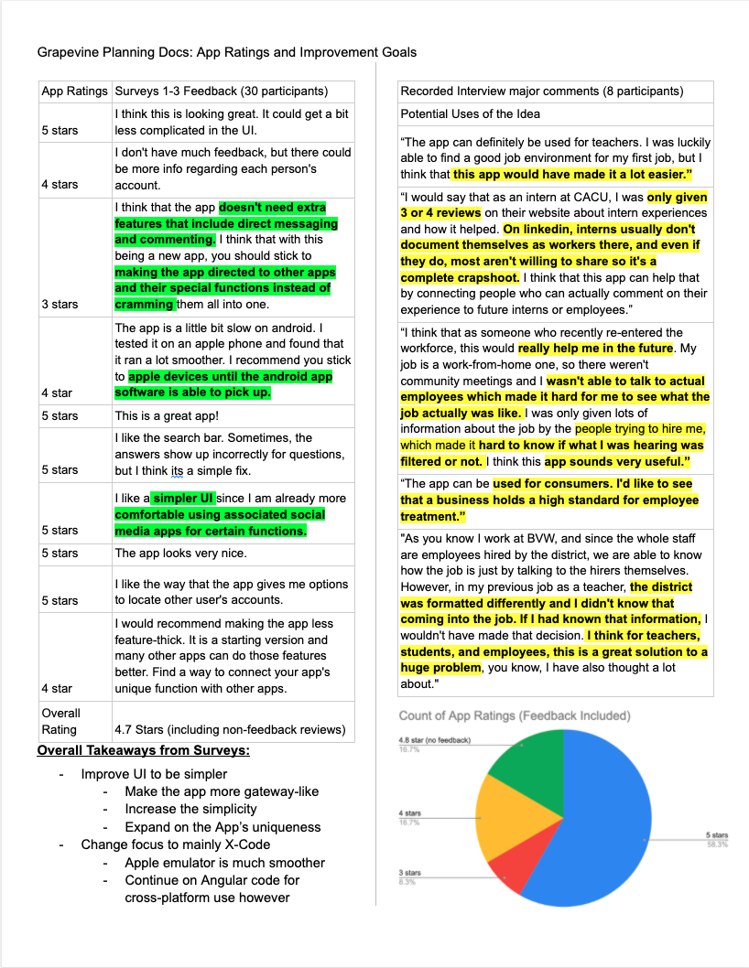
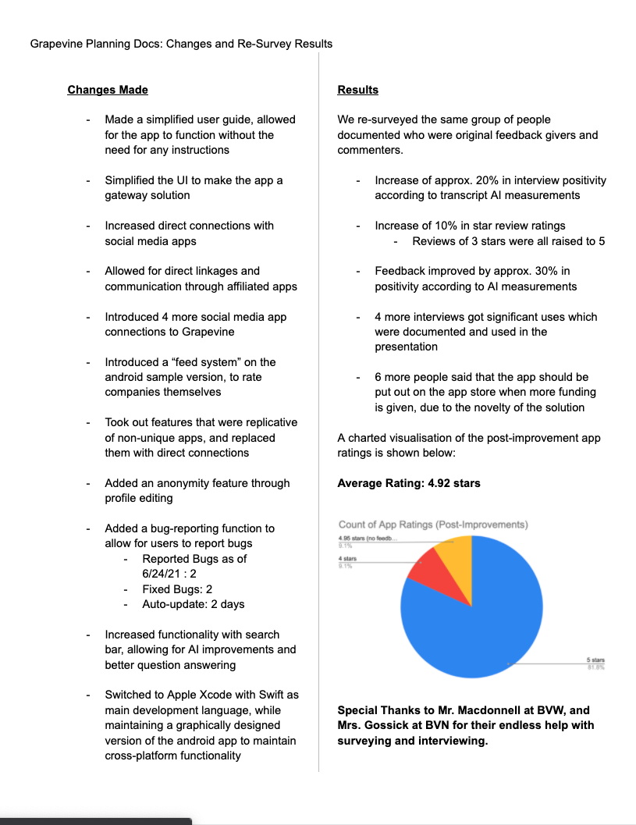
PLANNING
OPTIMIZED
SURVEY DATA AND
IMPROVEMENTS
Perfected based on user
satisfaction statistics
CONSISTENT
App design consistent
and intuitive
APP LAYOUT

Slide 5
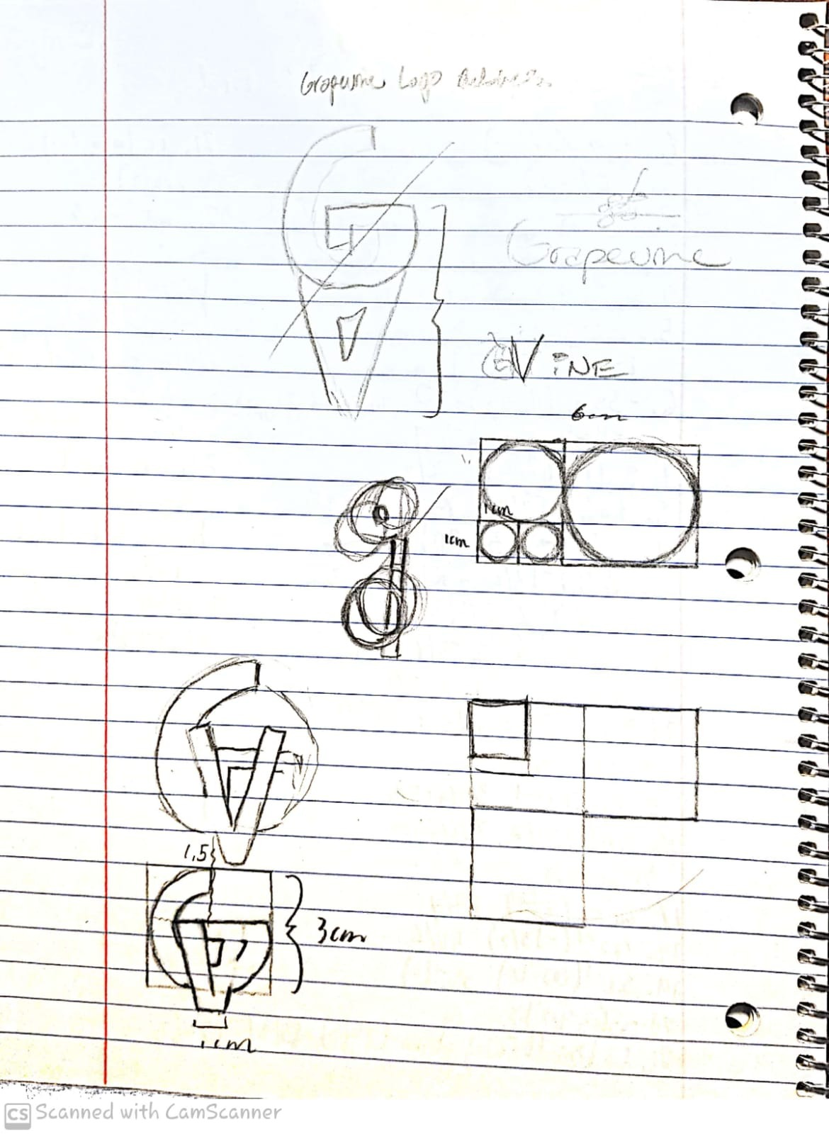
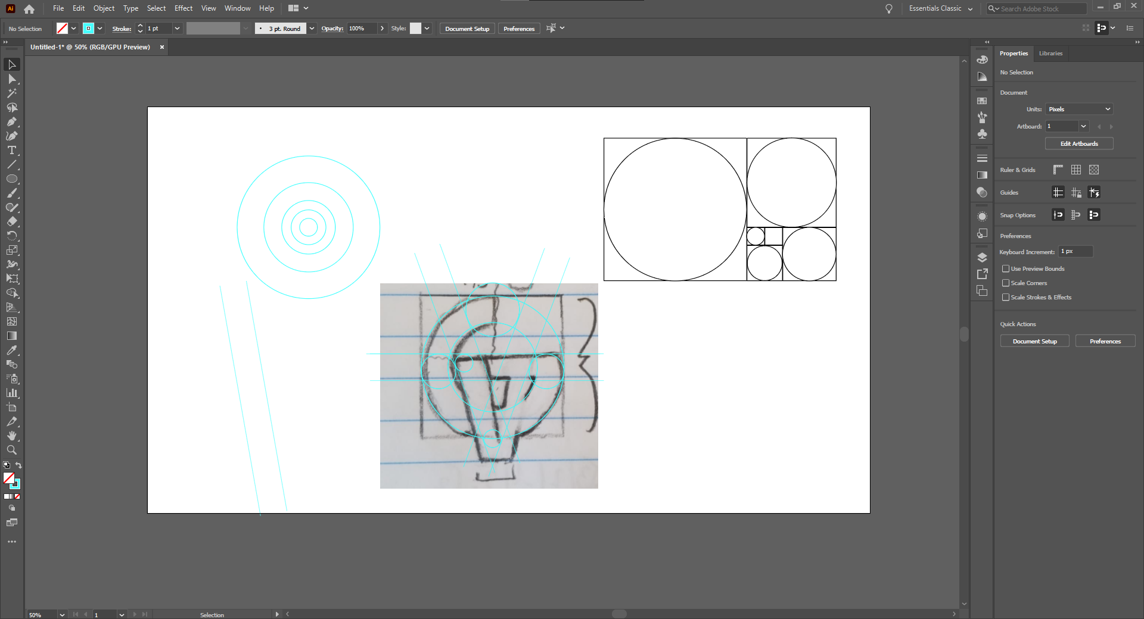
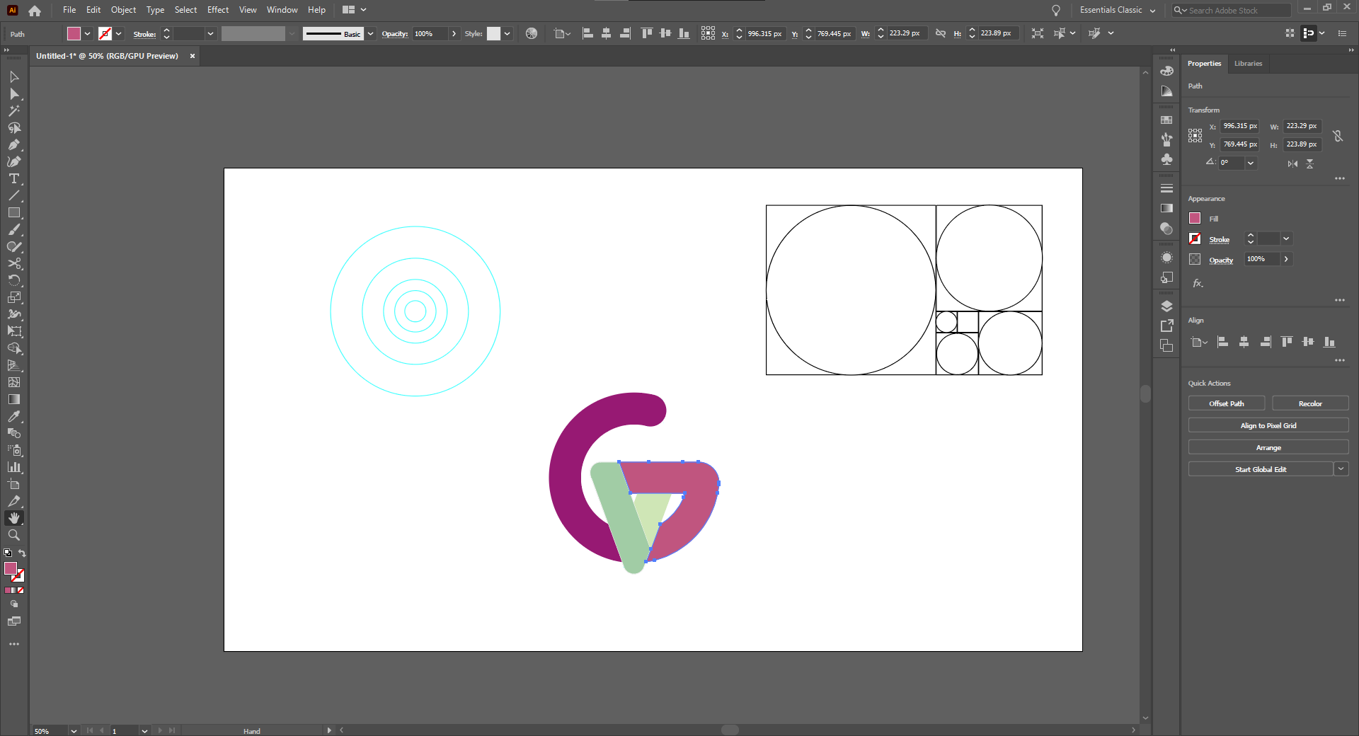
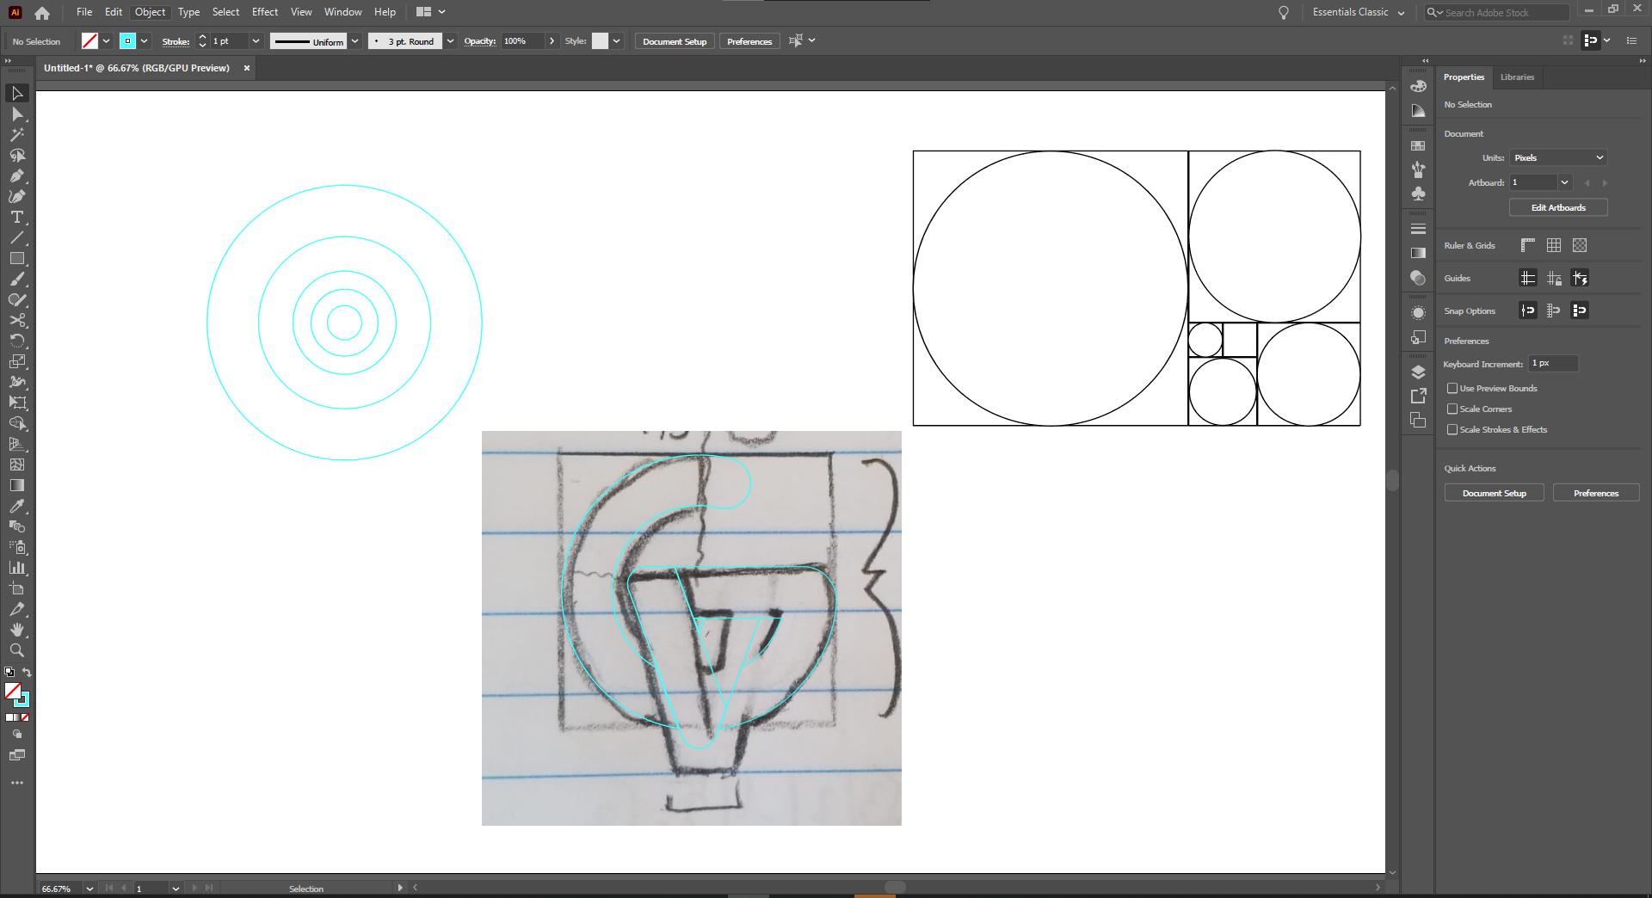
CREATION OF LOGO
STEP 1
STEP 3
Created the sketch for
the initial design
Using the golden ratio in Adobe Illustrator
to refine the sketch digitally
STEP 2
STEP 4
Plan out to use the golden ratio
design method to create a framework
Merge existing layers to create a canvas
and color portions accordingly

Slide 6
Demonstration

